Slide 1
Image Loading

Slide 2
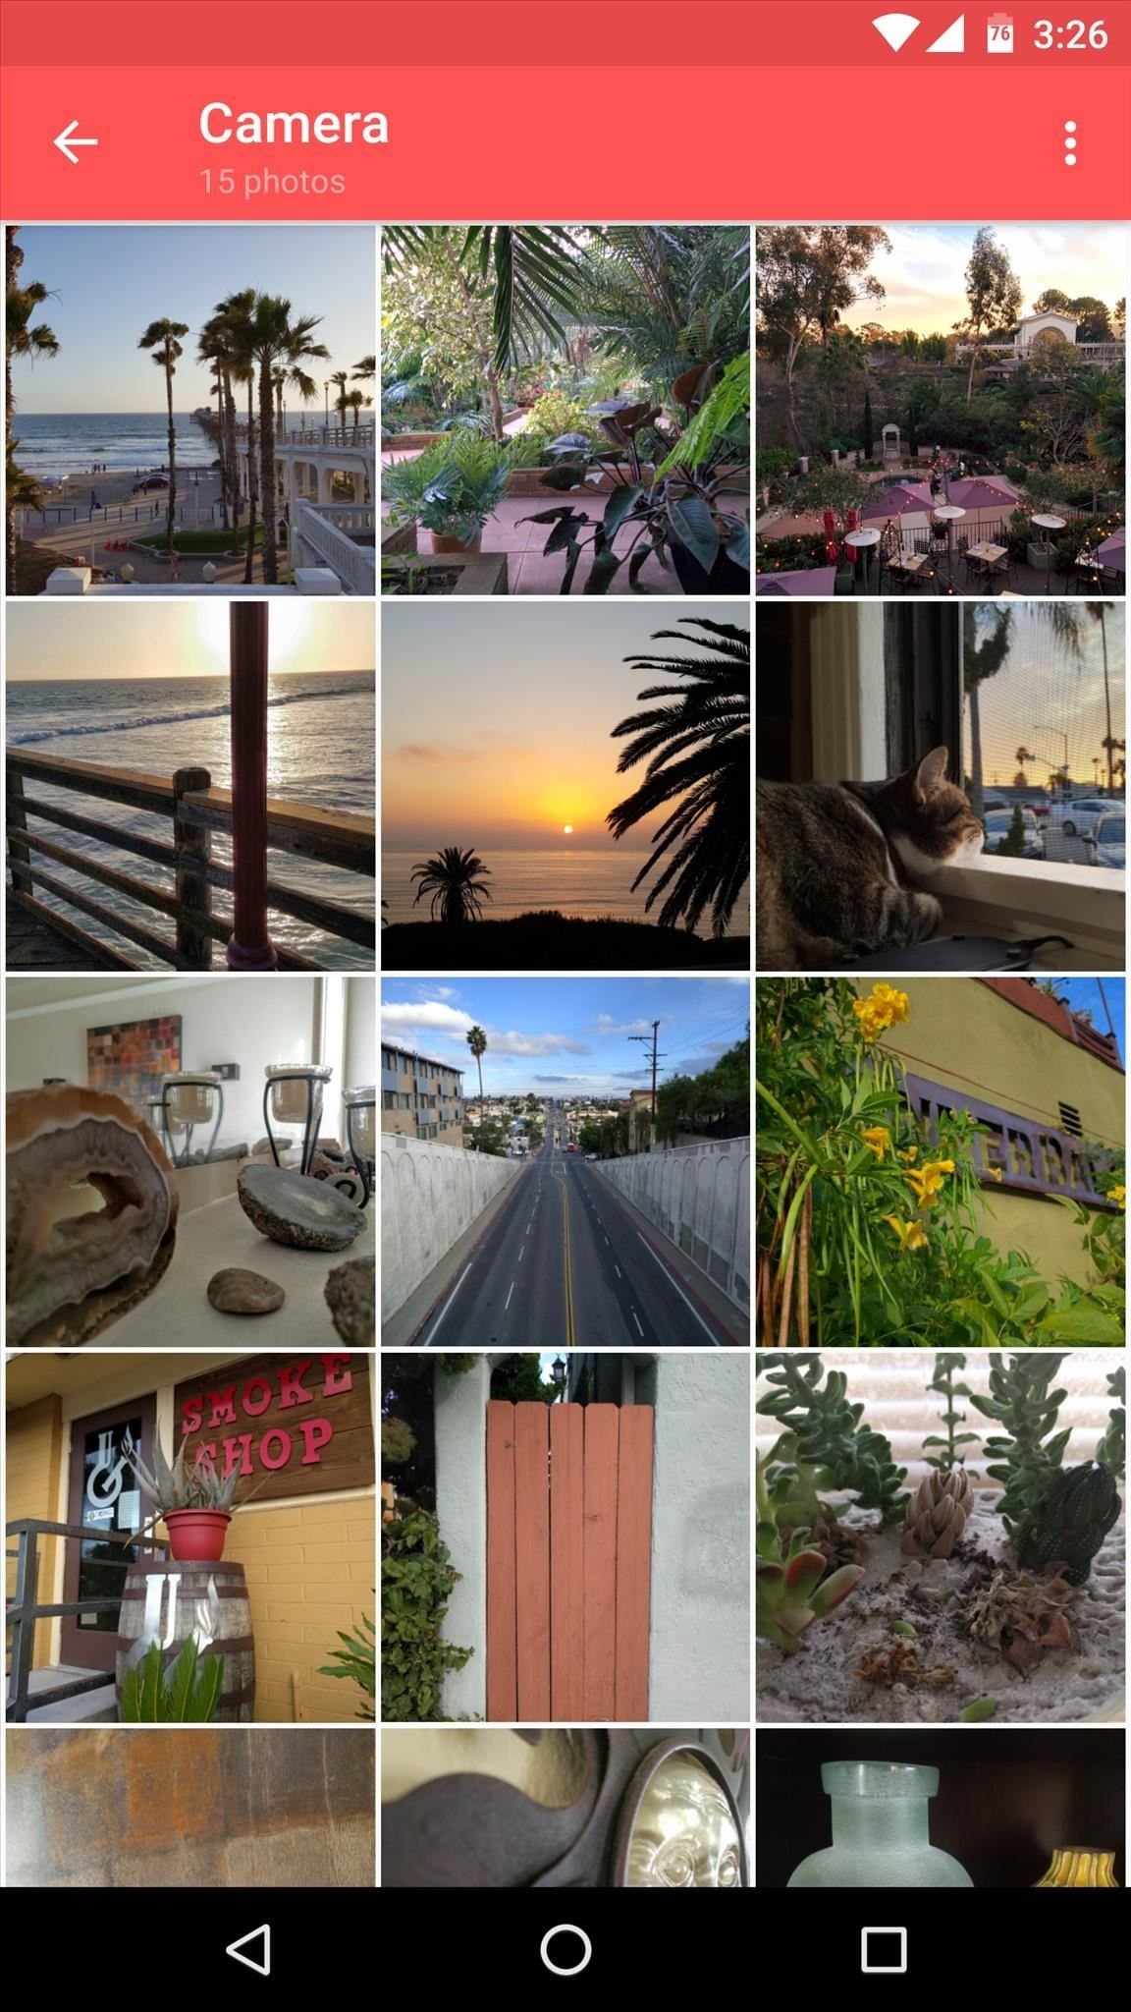
Image Loading
You can easily display PNGs / JPGs / SVG if under res/drawable.

Slide 3
Image Loading
You can easily display PNGs / JPGs / SVG if under res/drawable.
But what if you have to dynamically load?

Slide 4
Image Loading
You can easily display PNGs / JPGs / SVG if under res/drawable.
But what if you have to dynamically load?
SD Card
Download from the network

Slide 5
Image Loading
We could write it ourselves, but there are some considerations...

Slide 6
Image Loading
Great opportunity to use a library:
Picasso (Square)
Glide (Bumptech)
Fresco (Facebook)

Slide 7
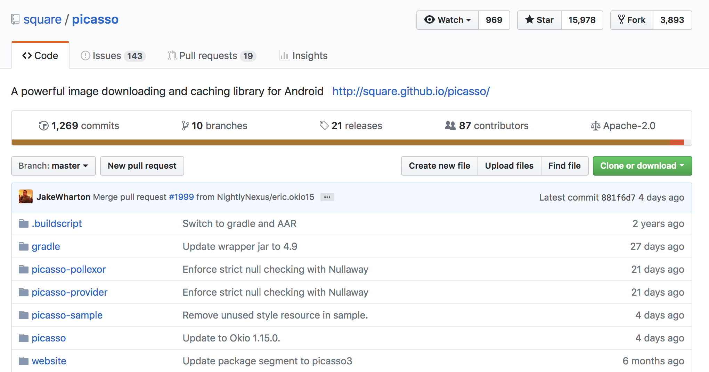
Choosing a Library - Example

Slide 8
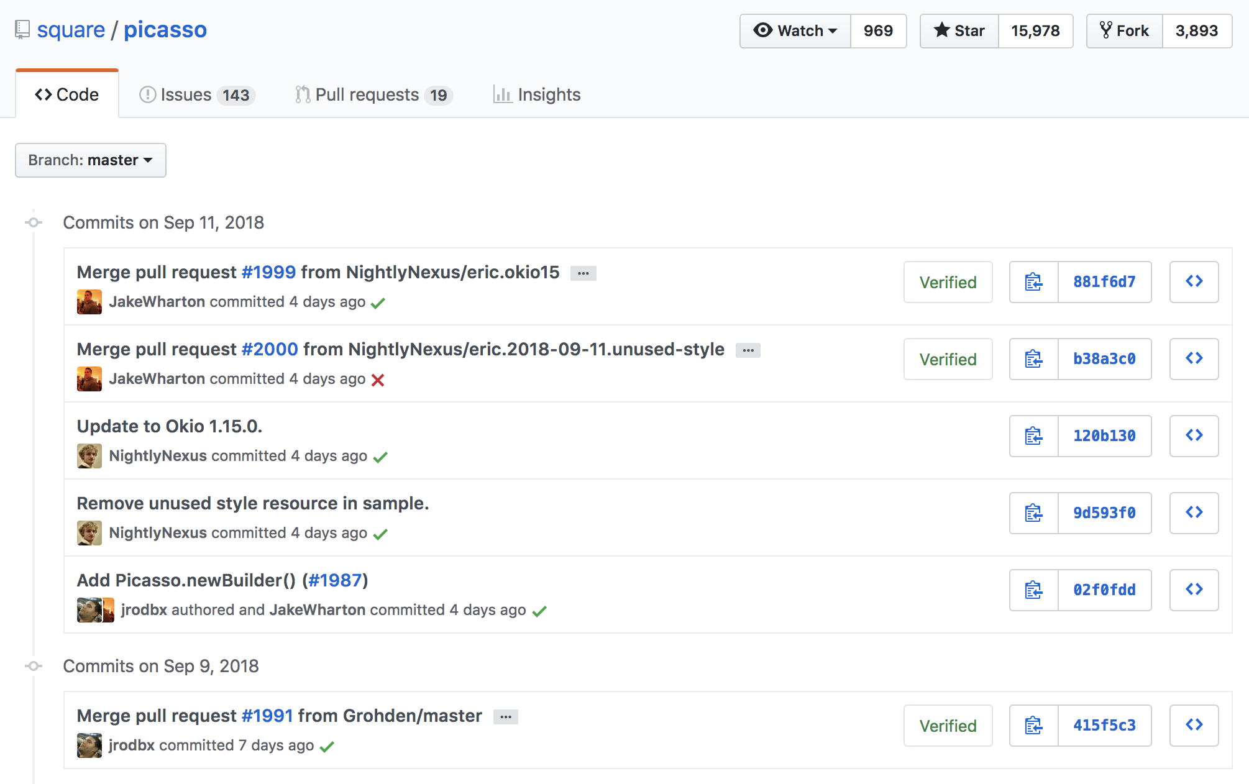
Choosing a Library - Example

Slide 9
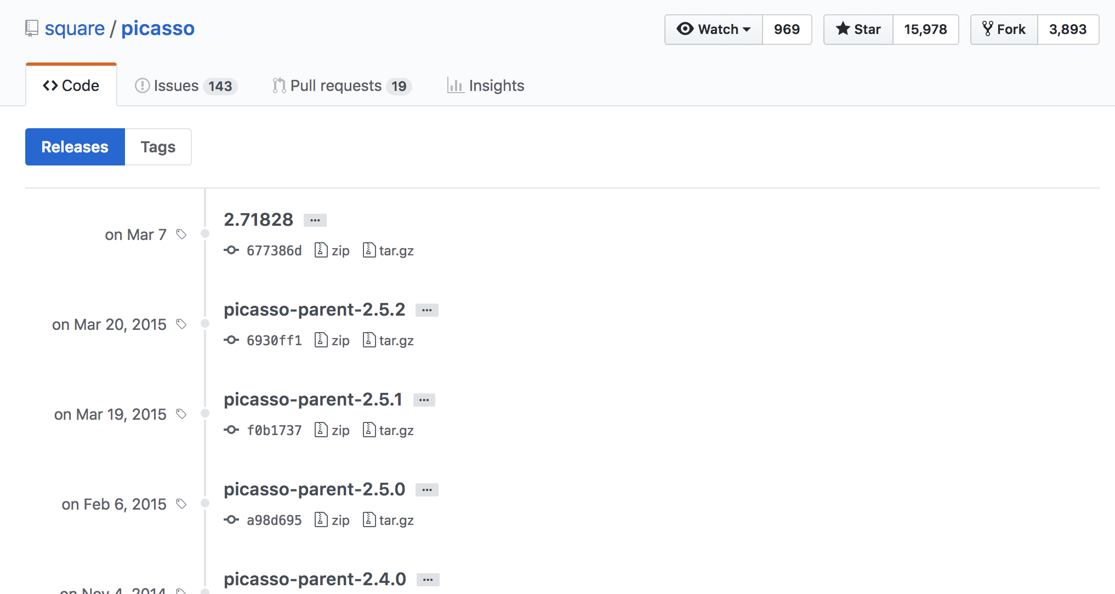
Choosing a Library - Example

Slide 10
Choosing a Library - Example
Other considerations?

Slide 11
Choosing a Library - Example
Generally, I’ve used Picasso in the past: it’s pretty simple, popular, and fairly mature.

Slide 12
Picasso - Usage
// First, add this to app’s build.gradle to automatically add Picasso to the project implementation 'com.squareup.picasso:picasso:2.71828'

Slide 13
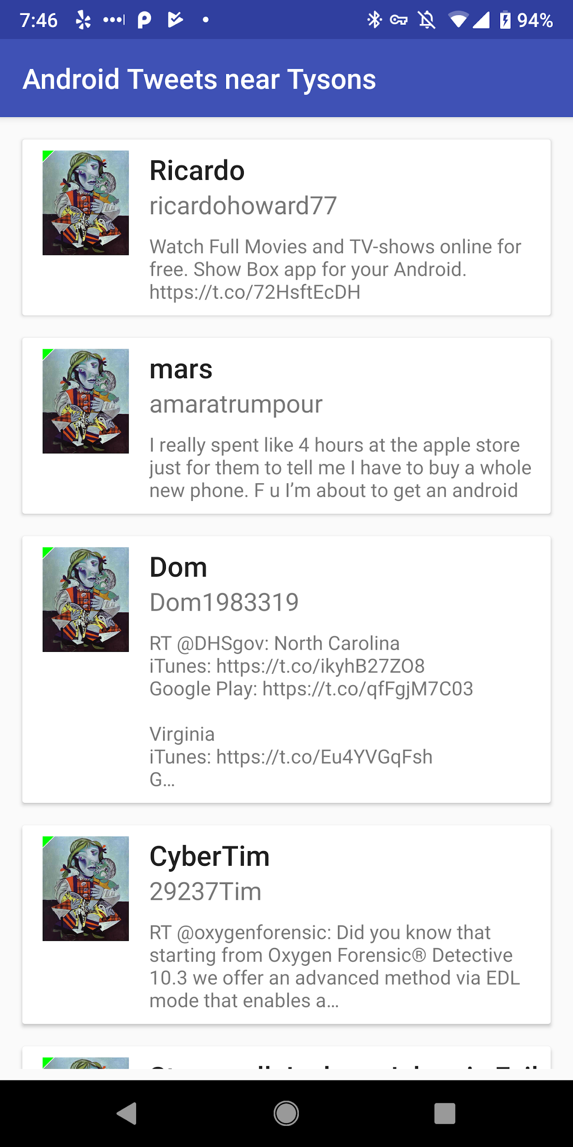
Picasso - Usage
// So we can see loaded from network vs. cache Picasso.get().setIndicatorsEnabled(true)
Picasso.get() .load("https://i.imgur.com/DvpvklR.png") .into(holder.icon)

Slide 14
No HTTP Traffic by Default on Newer Versions
Android restricts HTTP / cleartext networking on newer versions.
Twitter serves up icon URLs with both HTTP and HTTPS, we need to update to use the HTTPS icons
// In the TwitterManager - JSON parsing for Tweets
val profilePictureUrl = user.getString("profile_image_url_https")

Slide 15
No HTTP Traffic by Default on Newer Versions
Android restricts HTTP / cleartext networking on newer versions.
Twitter serves up icon URLs with both HTTP and HTTPS, we need to update to use the HTTPS icons
Other options if that were not available

